Slide 1
Data Science Africa
Classification
& Machine Learning
Mike Smith

Slide 2
Machine Learning
Artificial Intelligence?
Data Science? Learning from Data
Machine Learning?
Applied Statistics?

Slide 3
Some of my research
Bee tracking
Air pollution
Adversarial Examples
Types of Machine Learning
Classification
Real Example: Malnutrition Screening
Regression - Maths!
Object Recognition
Convolution Neural Networks
Other Applications of ML

Slide 4

My current projects include...
Developing a bumblebee tracking system

Slide 5

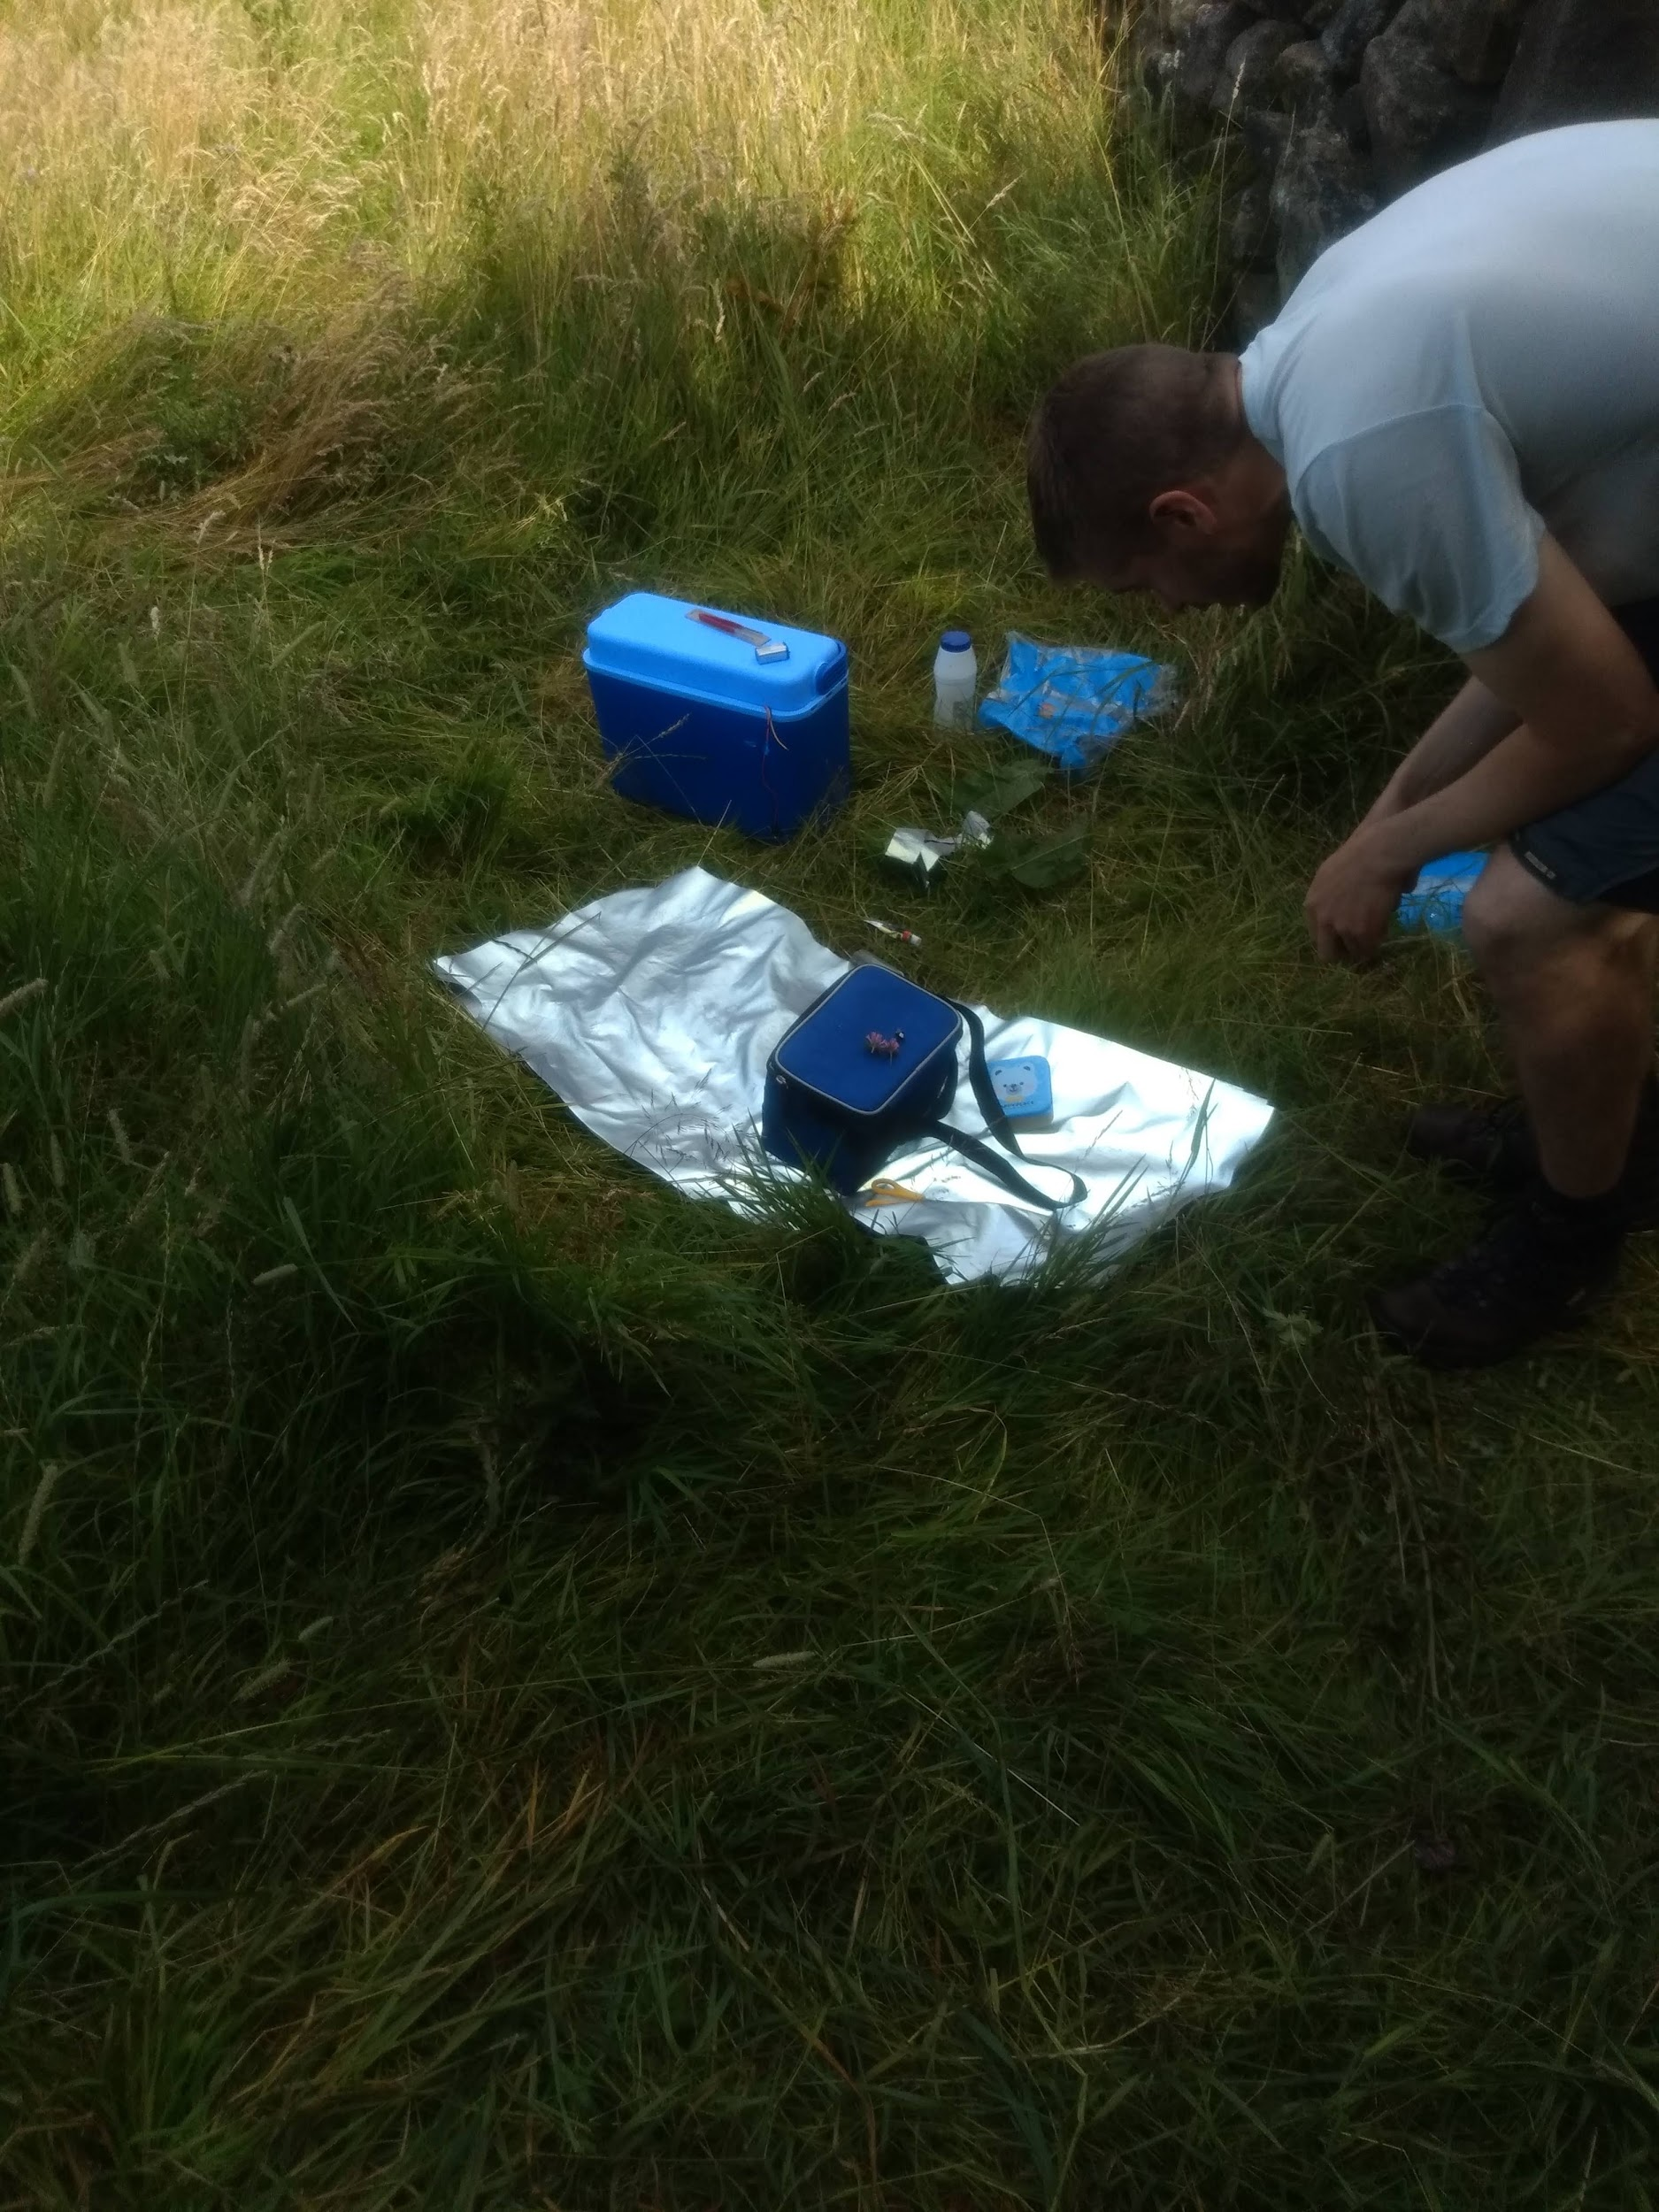

Stick a retroreflector on the back of the bee.

Slide 6
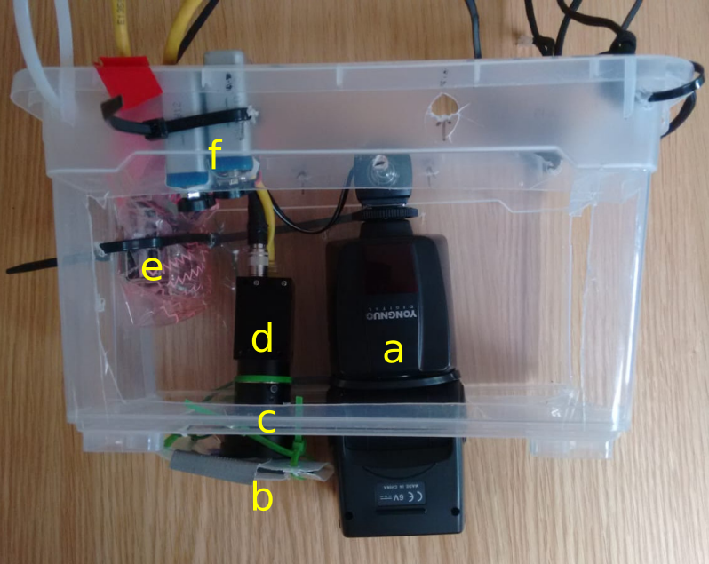
Take photos with & without a flash
Tracking system a. flash b. 390nm filter c/d. Camera and lens e. raspberry pi and control electronics f. 9V batteries

Slide 7

Take photos with & without a flash
Tracking system a. flash b. 390nm filter c/d. Camera and lens e. raspberry pi and control electronics f. 9V batteries

Slide 8

Take photos with & without a flash
Align them & subtract
Look for bright spot in result
Take photos with & without a flash
Align them & subtract
Look for bright spot in result
False positives caused by litter, butterflies (!), pollen, etc.
Need to do ML on the images to find the real bee.

Slide 9
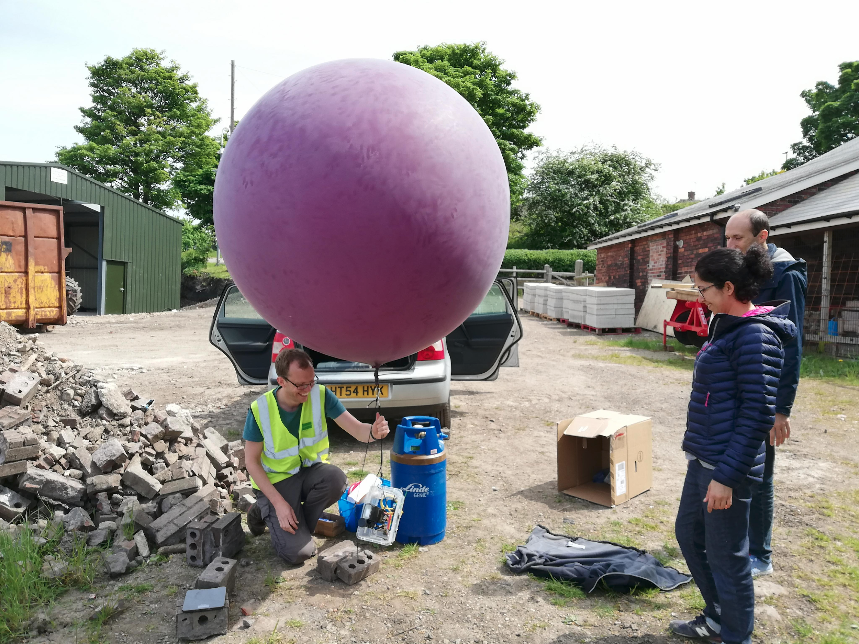
Also need to get the tracking system high enough… we tried drones, a tethered balloon & a mast.

Slide 10
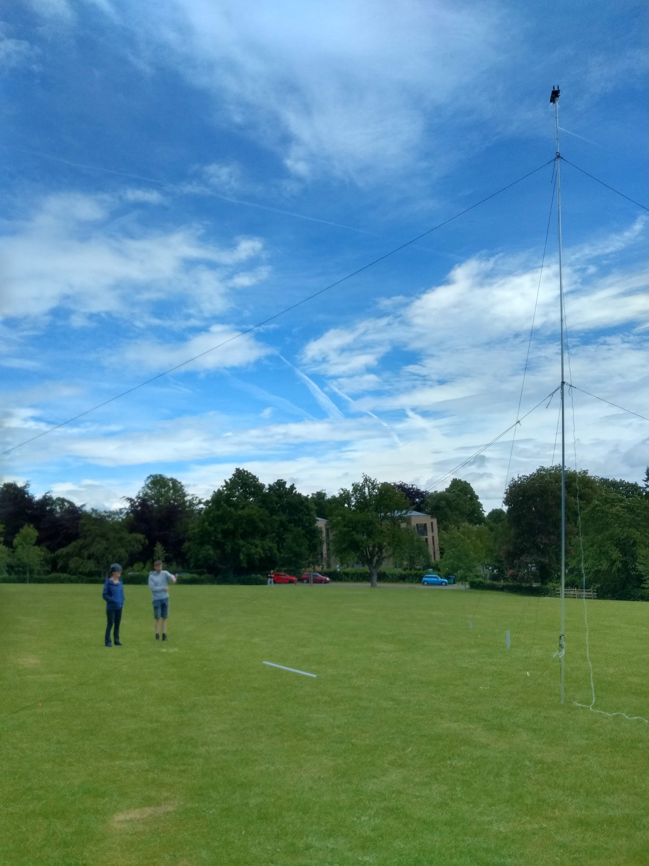
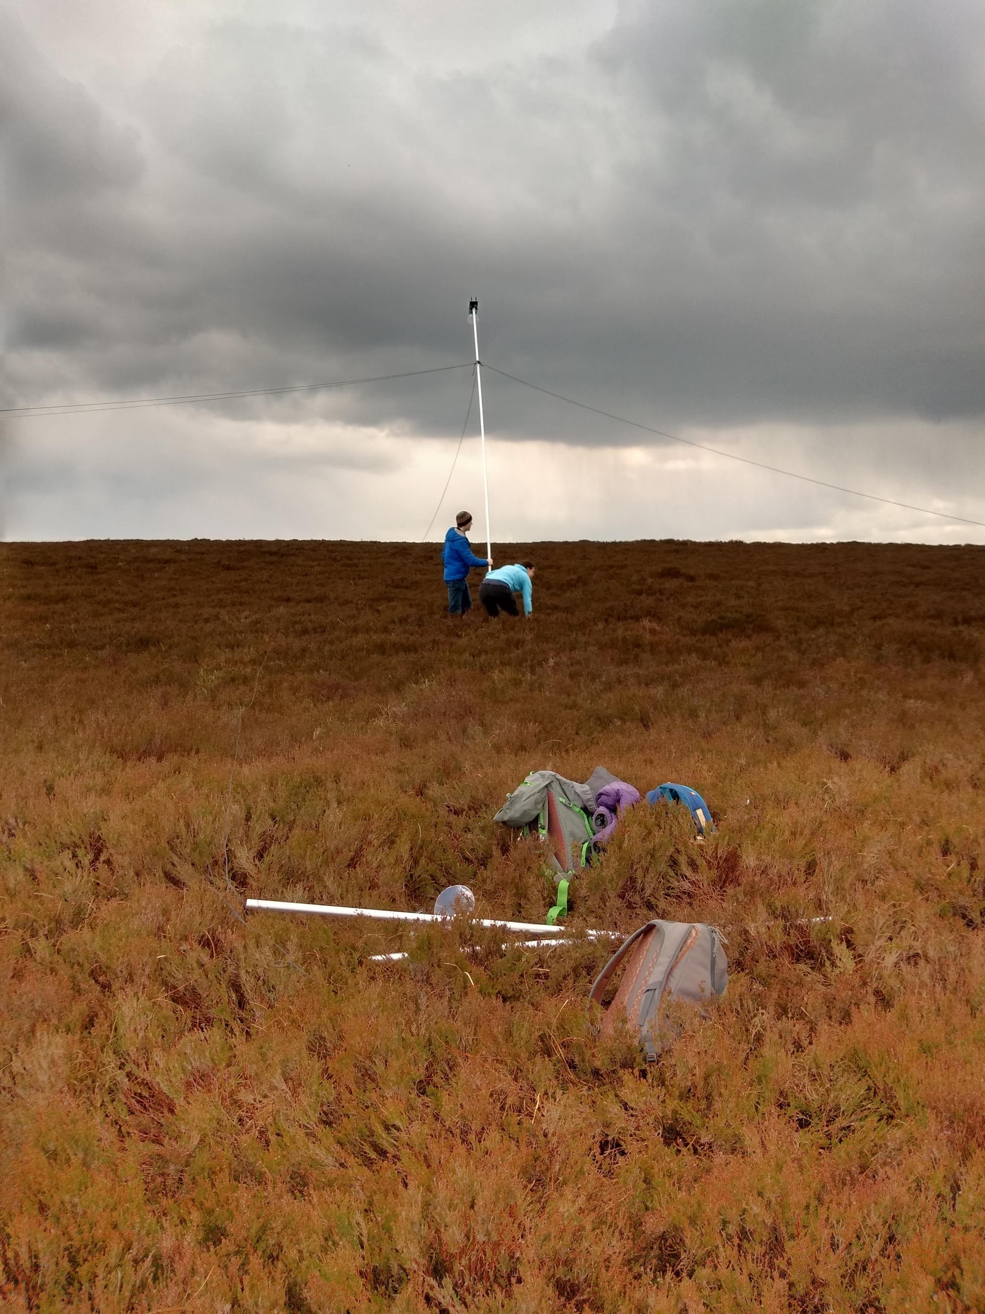

Slide 11
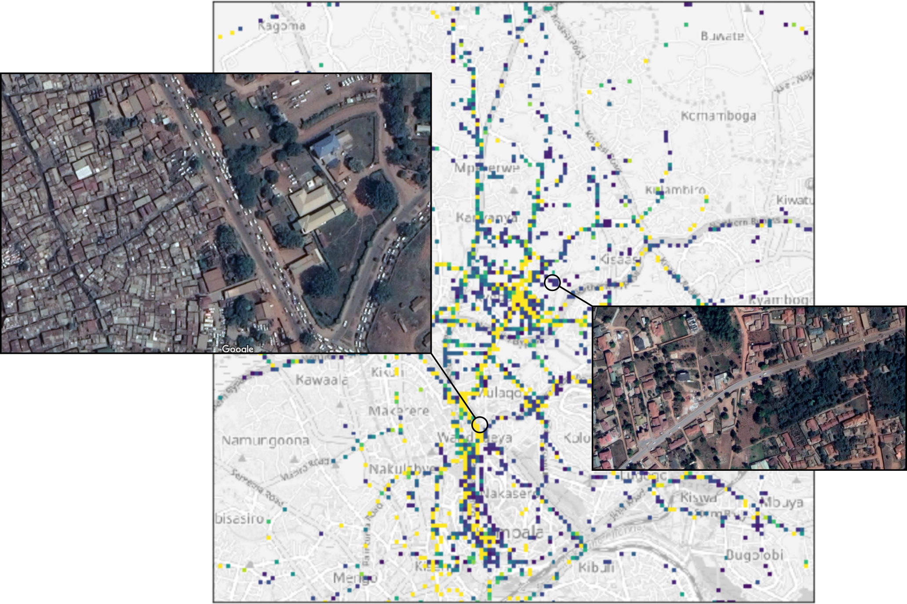
My current projects include...
Air pollution sensor network in Kampala, Uganda

Slide 12
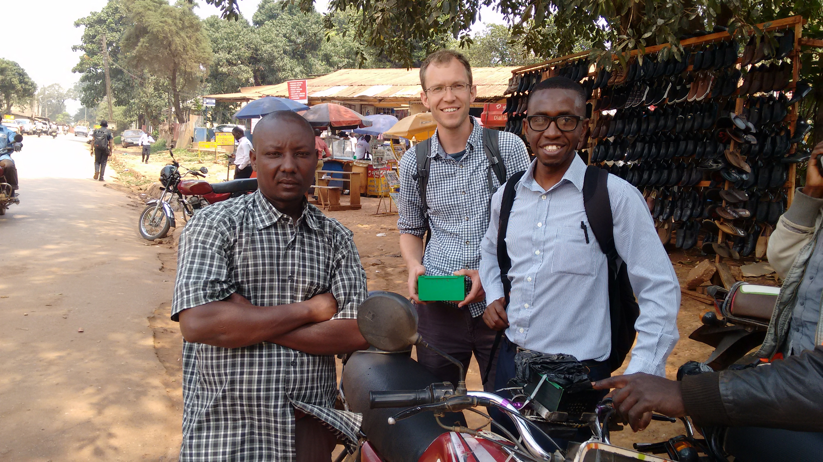
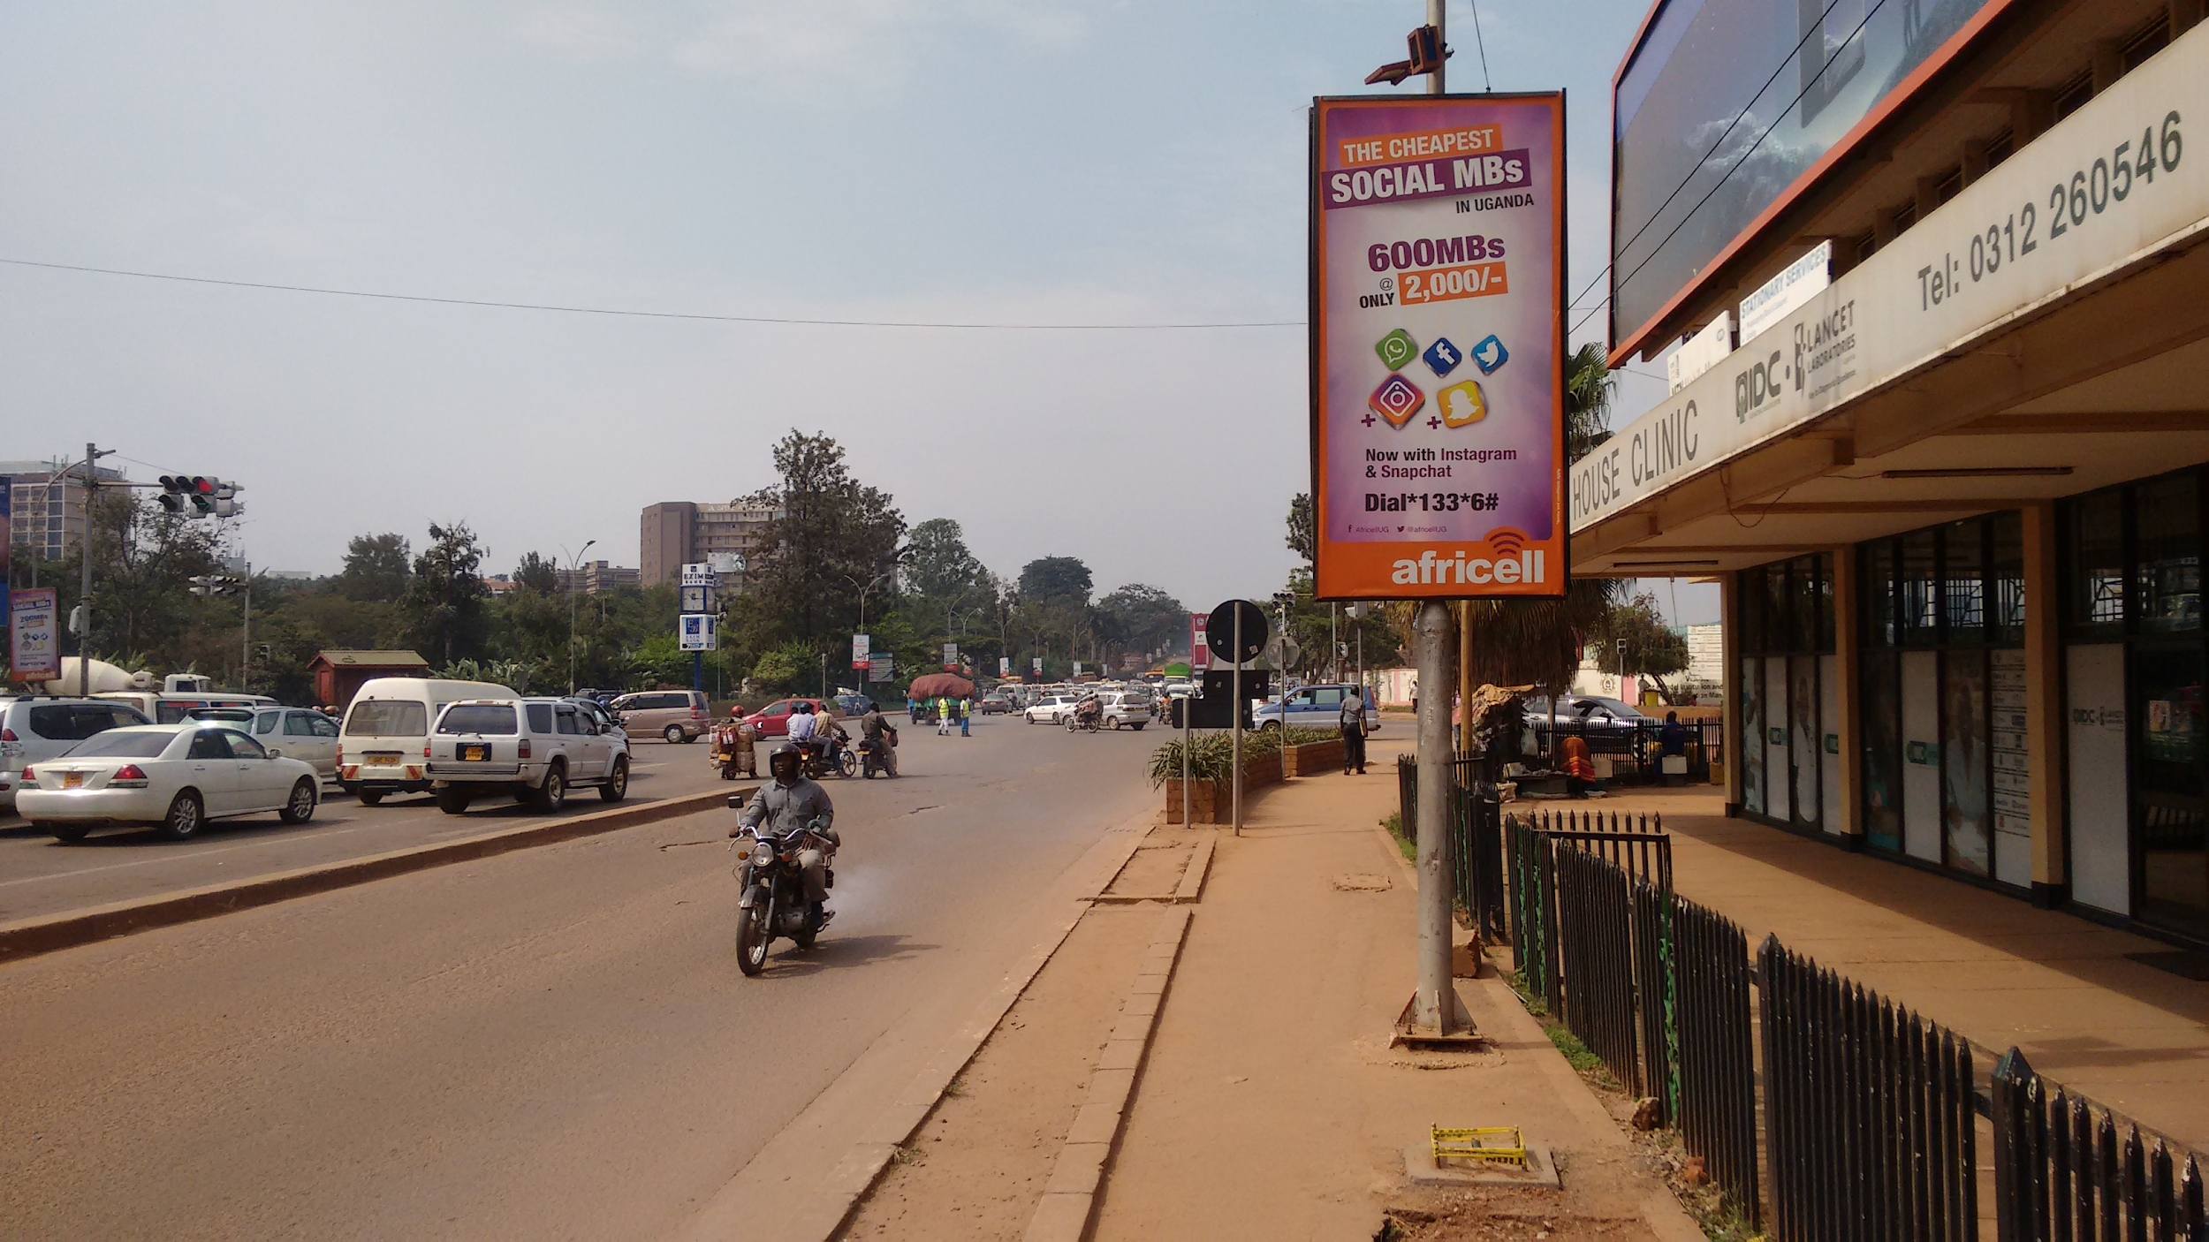
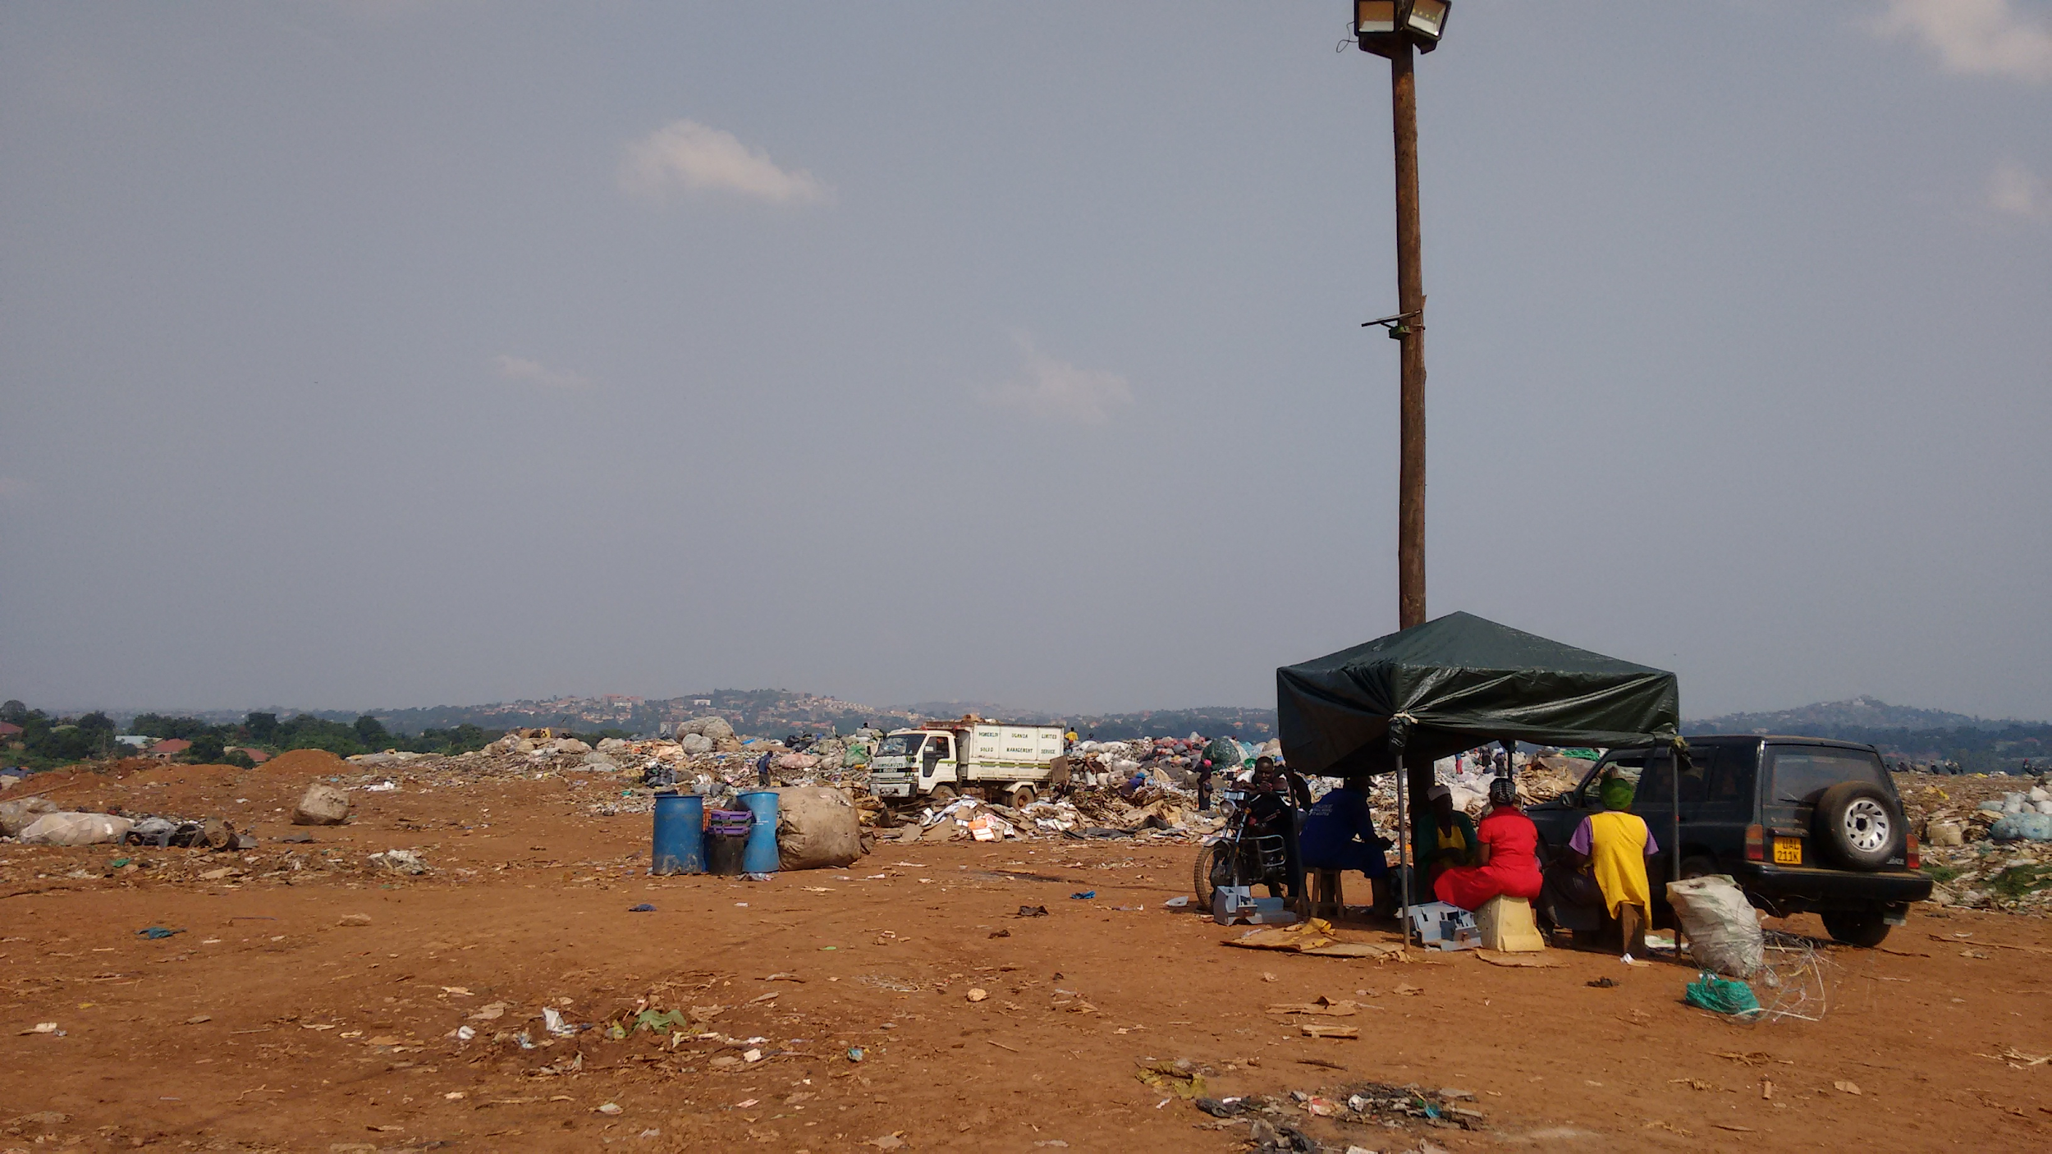

Slide 13
Challenges
Low cost sensors have biases.
Need regular calibration.
Need to use probabilistic inference to estimate pollution over space and time. Incorporates:
sensor bias
roads
land use
weather...

Slide 14
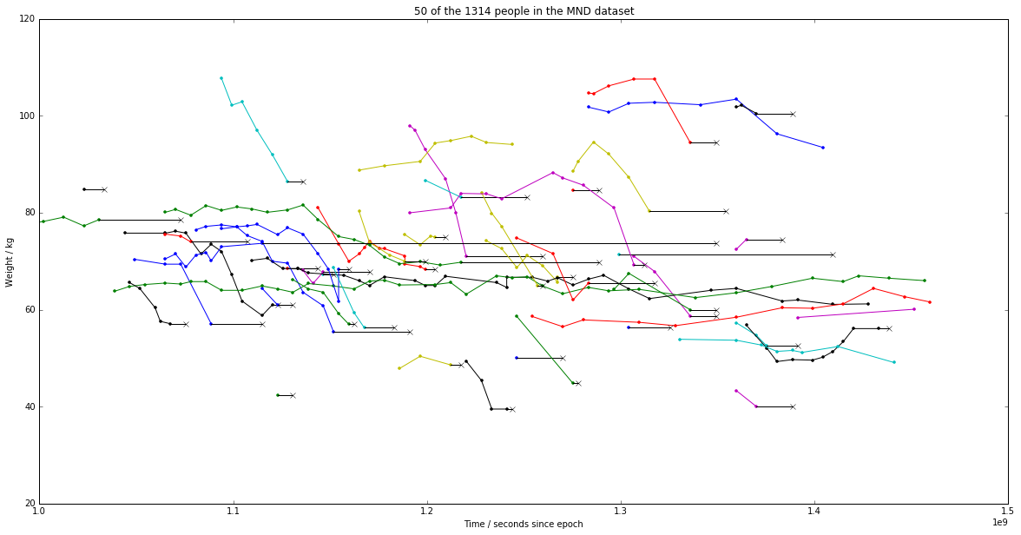
My current projects include...
Analysing Motor Neurone Disease progression

Slide 15
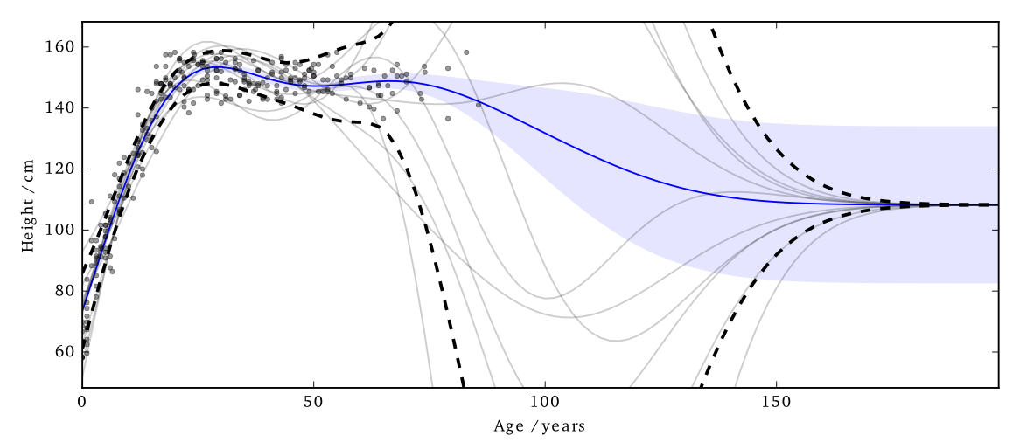
My current projects include...
Differential Privacy

Slide 16
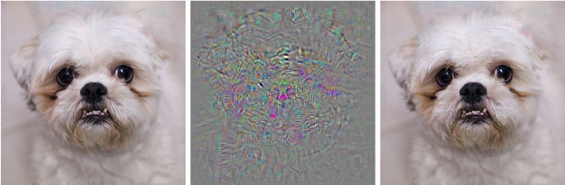
My current projects include...
Devising methods to protect ML classifiers from Adversarial Attack

Slide 17
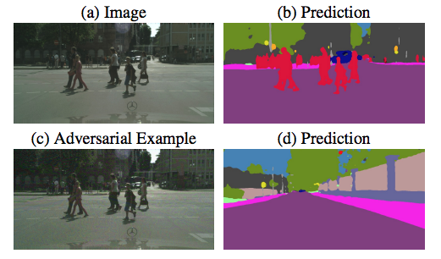
Adversarial Attack...

Slide 18
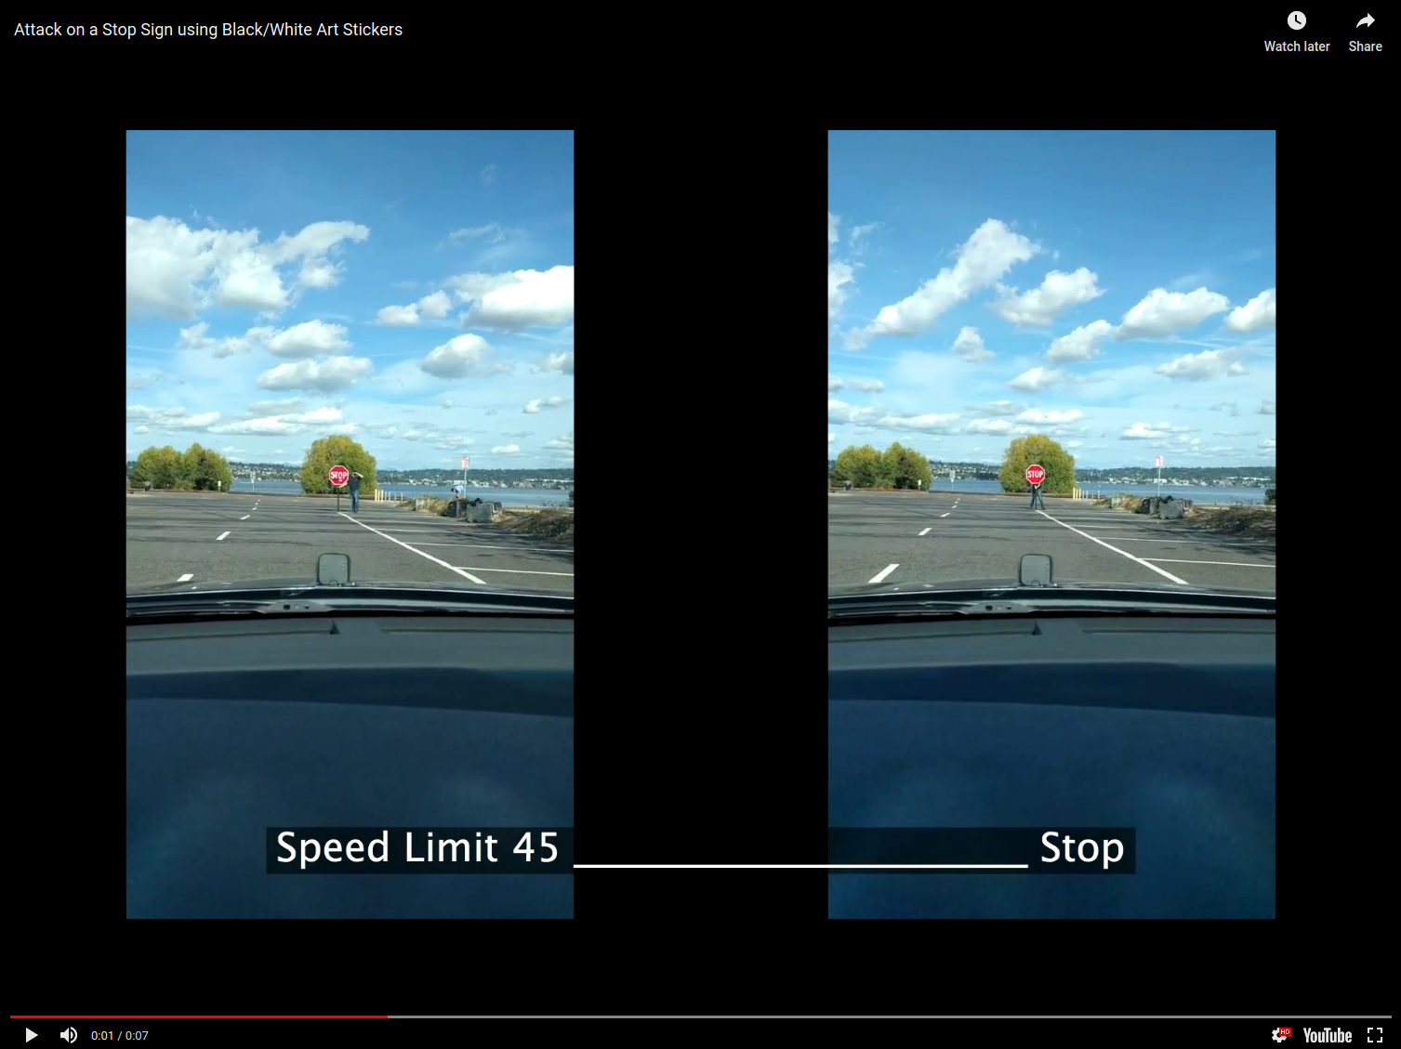

Slide 19
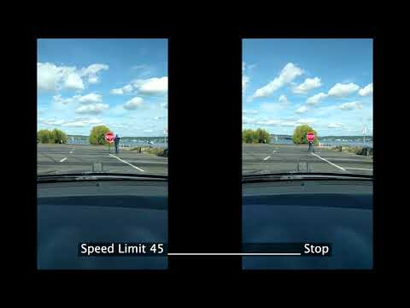

Slide 20
Types of Machine Learning
Supervised
Unsupervised

Slide 21
Types of Machine Learning
Supervised

Slide 22
Types of Machine Learning
Supervised
Classification
Classify if a dialysis patient will have high blood pressure.

Slide 23
Types of Machine Learning
Supervised
Classification
Classify if a dialysis patient will have high blood pressure.
Regression
Predict a dialysis patient’s blood pressure
value.

Slide 24
Types of Machine Learning
Unsupervised

Slide 25
Types of Machine Learning
Unsupervised
Clustering

Slide 26
Types of Machine Learning
Unsupervised
Clustering
Identify clinically useful subgroups of motor neurone disease.

Slide 27
Types of Machine Learning
Unsupervised
Clustering
Identify clinically useful subgroups of motor neurone disease.
also Dimensionality Reduction
Identify key factors that describe the patient population.

Slide 28
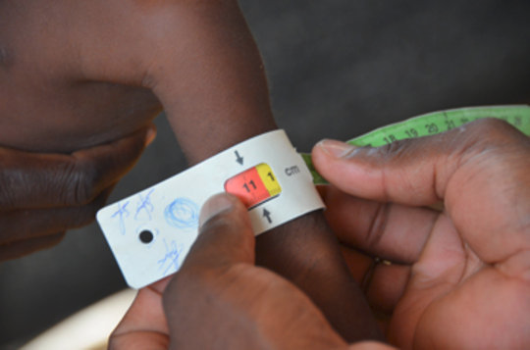
Solve Real Challenges:
Acute
Malnutrition
Screening
Which children need extra feeding?

Slide 29
Need to do Classification
Look at training data (previous children) to decide on treatment.
But what features of the previous children are important?

Slide 30
Need to do Classification
Look at training data (previous children) to decide on treatment.
But what features of the previous children are important?
Arm Circumference Weight-score

Slide 31
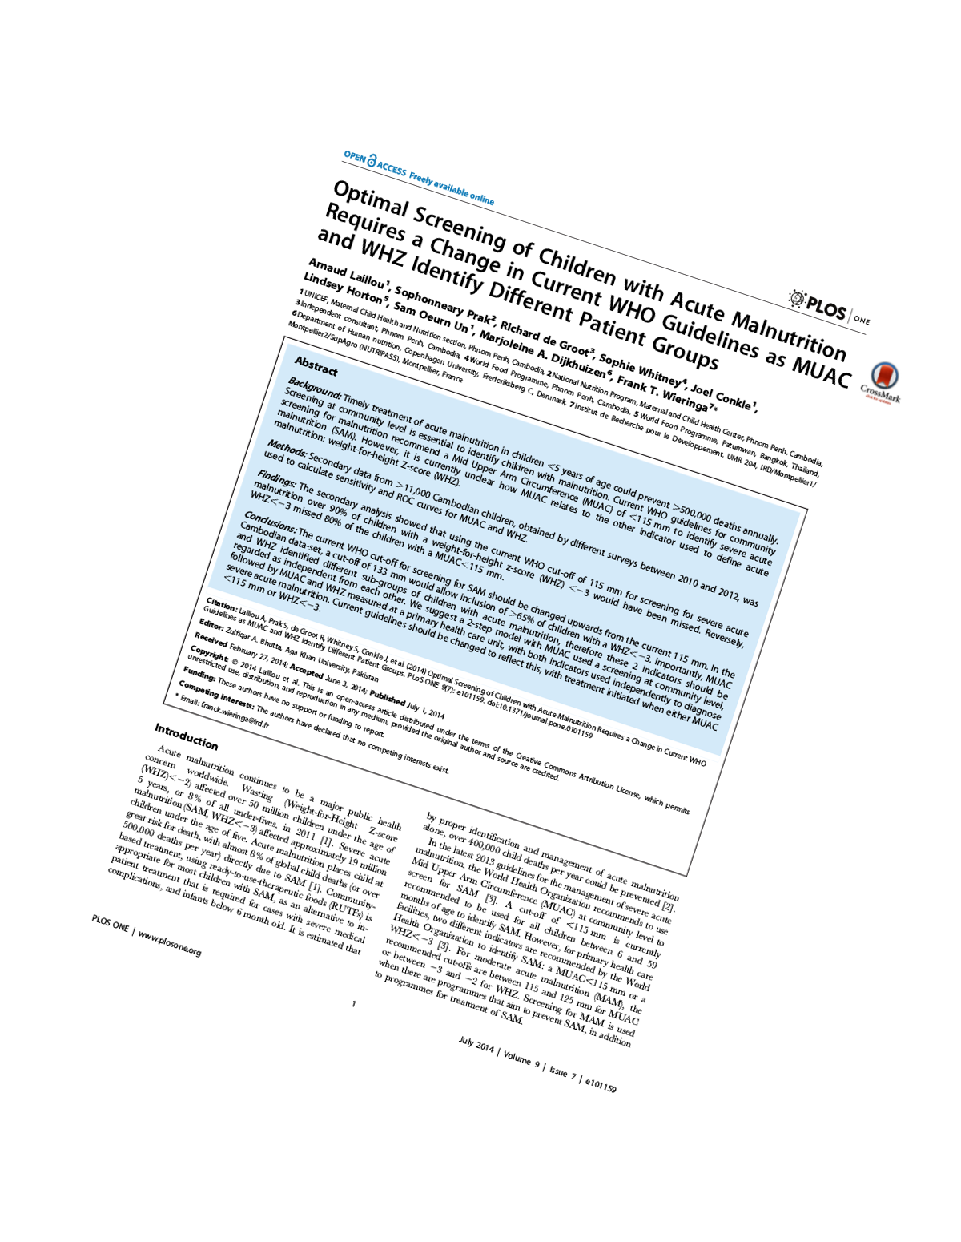
But what features
are important?
Arm Circumference Weight-score

Slide 32
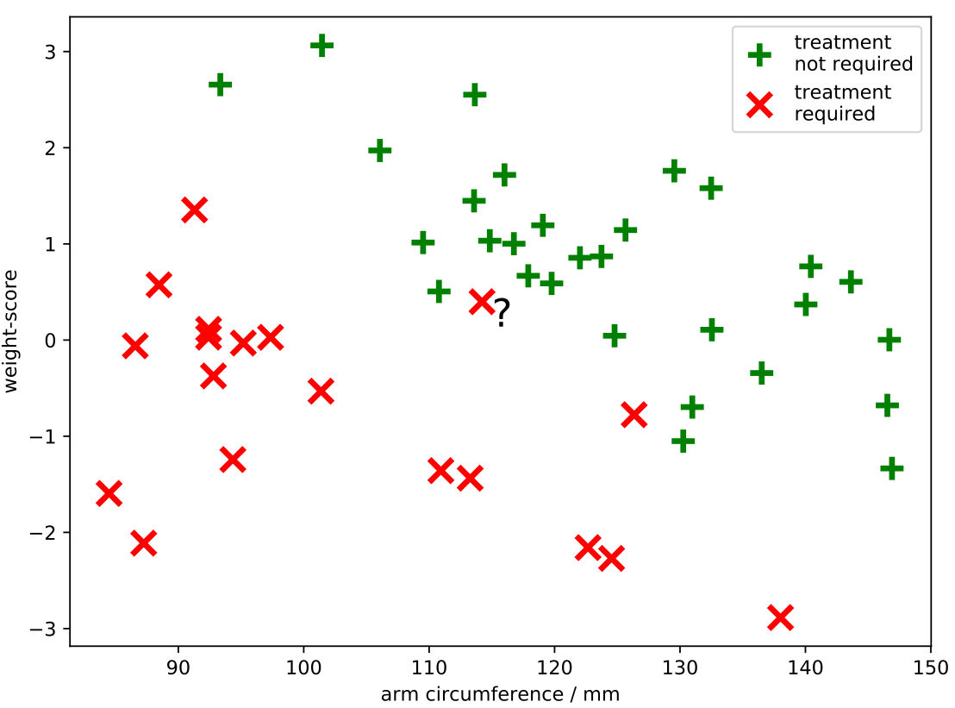

Slide 34
How to assess our classifier?

Slide 35
How to assess our classifier
To test our classifier we split our data into a training set and a test set.
We can do this repeated, leaving out one or more data points to use as test data & training on the rest. This makes efficient use of the data. It is called cross-validation.

Slide 36
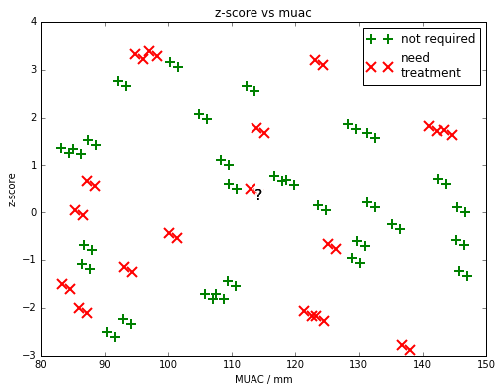
Note on left out data...
When splitting your data into training and test, it is important to avoid accidental correlations which confound your evaluation of your classifier.

Slide 37
Note on left out data...
...for example if many of the children had siblings that might have similar features, the evaluation could be artificially improved.

Slide 38
Validation
There may be hyper parameters we can adjust in our model, such as the number of neighbours, or the curviness of the decision boundary.
We could keep messing with these to get a really good classifier, but if we’re doing this by looking at the test data we’ve ‘cheated’.

Slide 39
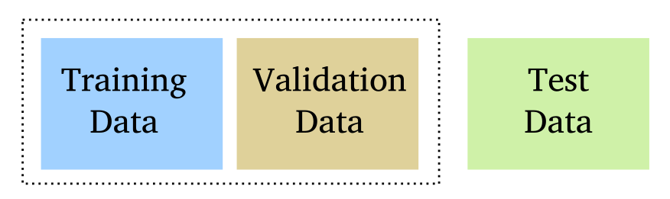
Validation
Instead we hold out some test data, and use validation data to adjust our model’s hyperparameters.

Slide 40
Detour: Linear Regression
Here we quickly look at how we compute the ‘w’ and the ‘c’ for linear regression.
The same approach can apply for logistic regresion, and for more complex classifiers.

Slide 42
y = mx + c

Slide 43
How to get m and c?
You need to do some differentiation!
y = mx + c

Slide 44
How to get m and c?
You need to do some differentiation!
y = mx + c

Slide 45
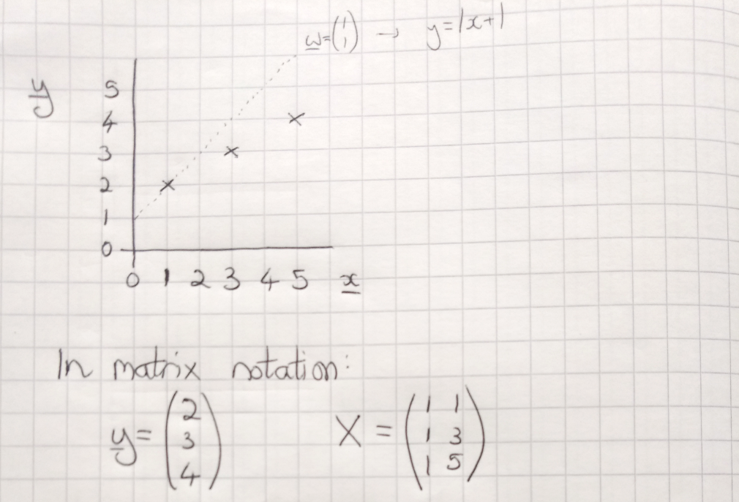

Slide 46
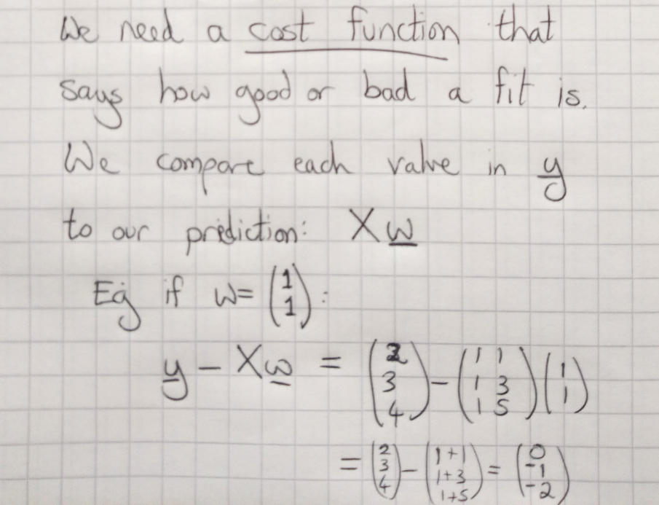

Slide 47
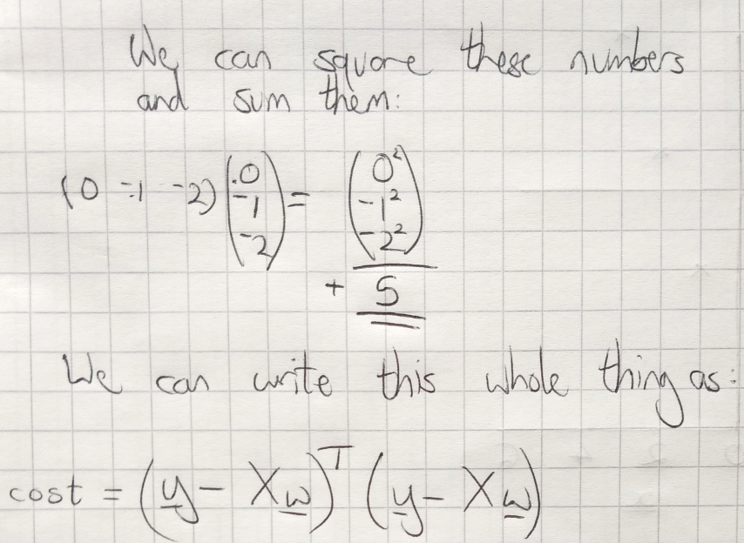

Slide 48
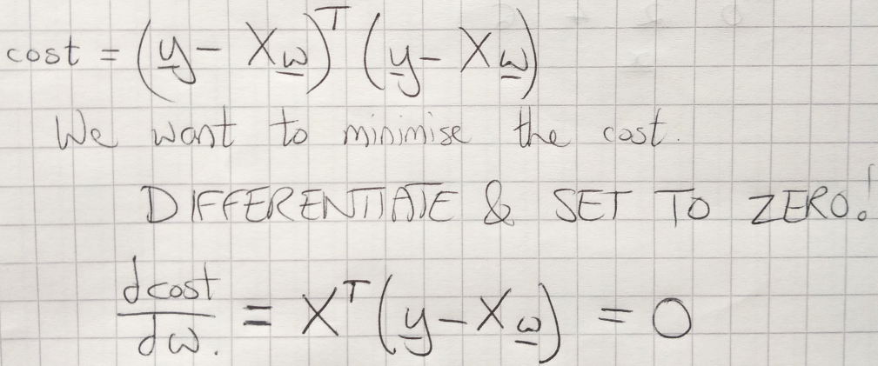

Slide 49
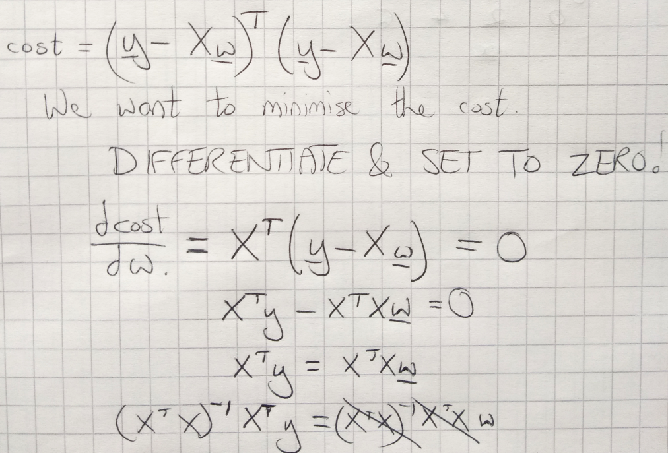

Slide 50
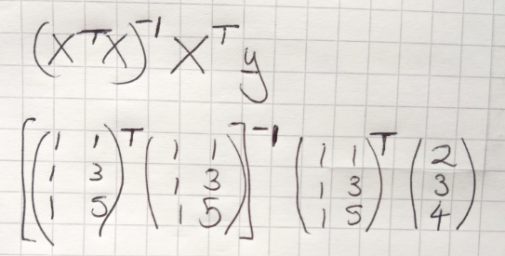

Slide 51
Summary #1
Machine learning can do classification
We need training data
We need to decide on features
We need to decide on the algorithm
(nearest neighbours, logistic regression etc)
We need to test and validate the method

Slide 52
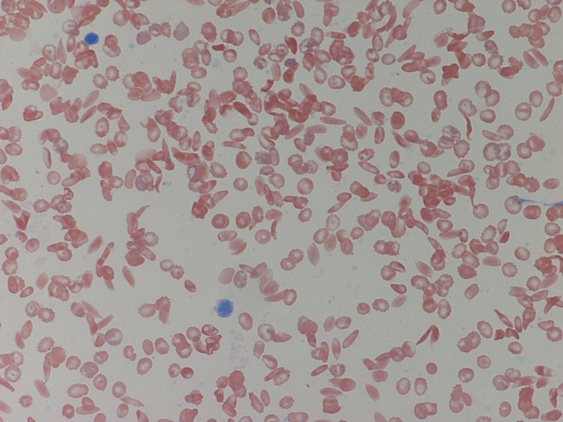
Object Recognition
Another example from Kampala:
Classify which cells are sickle cell

Slide 53




Object Recognition
Another example from Kampala:
Classify which cells are sickle cell

Slide 54
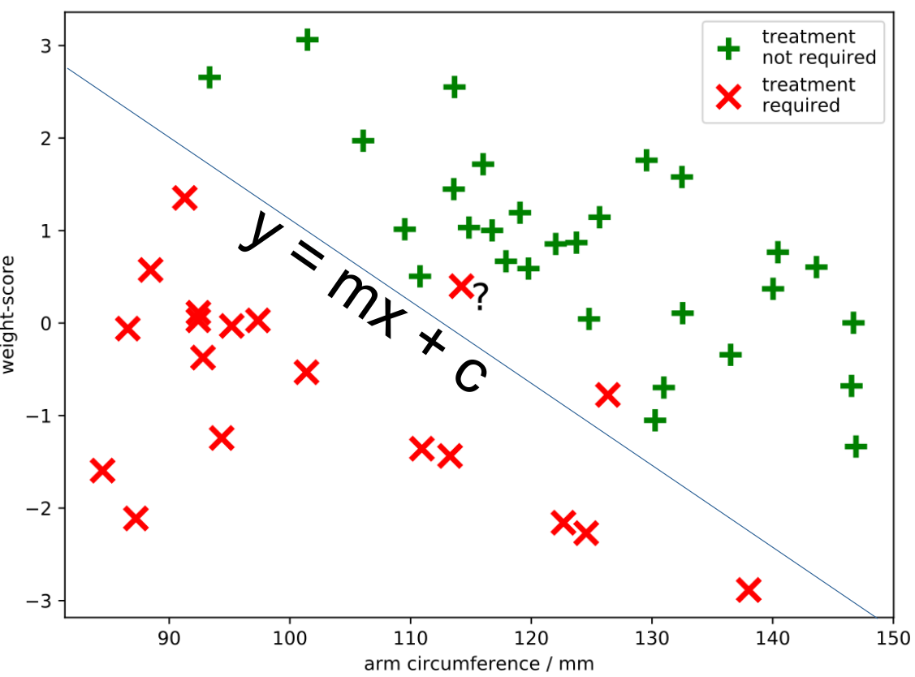
Object Recognition
Another example from Kampala:
Classify which cells are sickle cell

Slide 55

Object Recognition
Another example from Kampala:
Classify which cells are sickle cell

Slide 56
Object Recognition
Images are more complicated!
Lots of possible features
(edges, corners, textures, etc)

Slide 57
Object Recognition
Images are more complicated!
Lots of possible features
(edges, corners, textures, etc)
A classifier called a convolutional neural network effectively decides on the features itself.
Same as before: it needed training data!

Slide 58
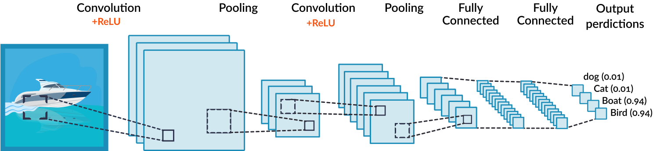
Convolutional Neural Network
Just like with y = mx + c line, but here we have lots and lots more parameters!
(often millions)
Need lots of data to help choose them.
missinglink.ai

Slide 59

Convolutional Neural Network
Not necessarily clear what each layer is doing…
Difficult to estimate confidence.
Needs a lot of data.
missinglink.ai

Slide 60
Another Detour:
The ROC curve

Slide 61
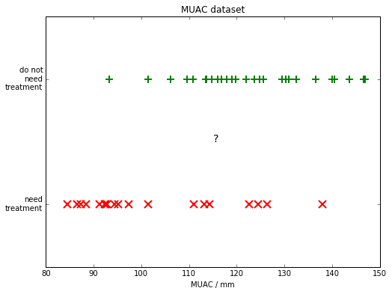
ROC stands for Receiver operating characteristic.

Slide 62
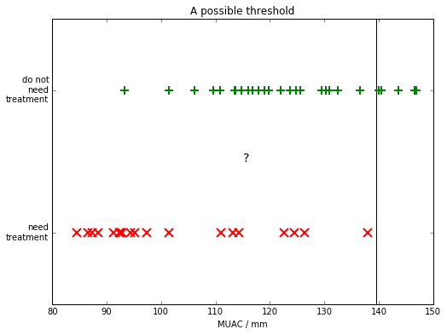

Slide 63
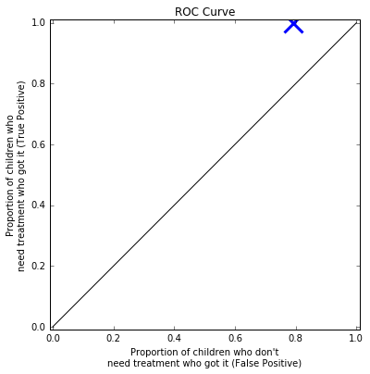

Slide 64
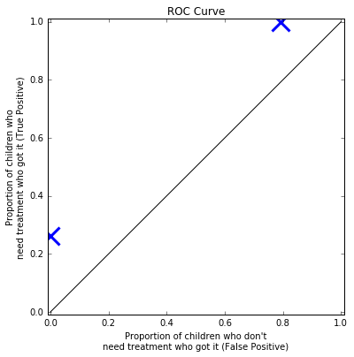
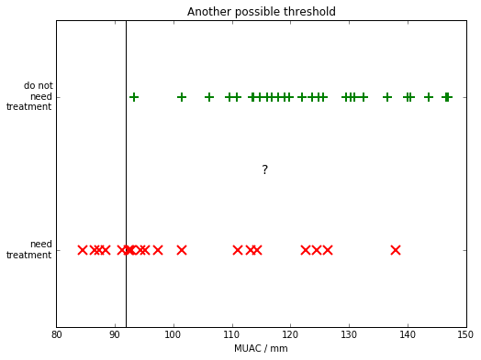

Slide 65
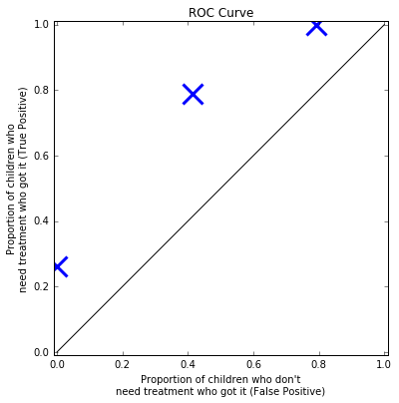
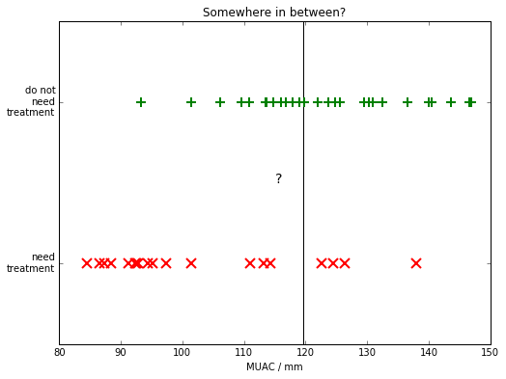

Slide 66
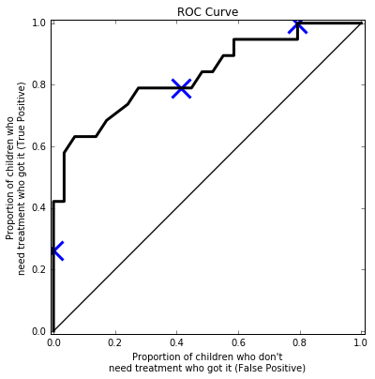
This is the ROC curve and is often used to compare classifiers
(compare the area under the curve).

Slide 67
Can combine with other methods. E.g. differential equations/physics control theory

Slide 68
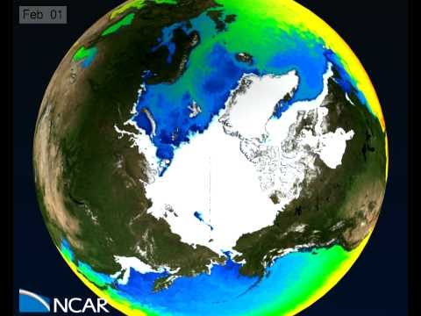
Can combine with other methods. E.g. differential equations/physics control theory

Slide 69
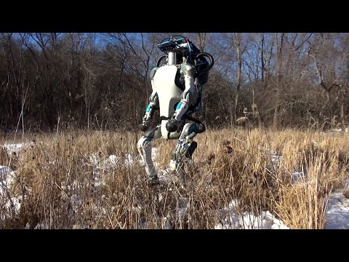
Can combine with other methods. E.g. differential equations/physics control theory

Slide 70
demo!

Slide 71
Summary #2
Classifier can only recognise what it’s been trained on.
Fails in new situations!
Can it be overconfident?
Needs lots of data: can we be more efficient?

Slide 72

Thank you!
Questions?

